Slide 1
Game Development 2B
Hashtables

Slide 2

Hash tables
Enormous array
Mostly empty or sparsely populated
Items put into the data structure via their hashing number
Allows for quick insertion and access
No longer need to search the array
You look in the position of the hash

Slide 3
Hash table structure
Large array
Start with size X, can increase later
You map a given value to some number between 0 and X
Ideally each value will hash to a unique index
Collisions can happen

Slide 4
Keys and hashing
Key
Key, the data value to be encrypted
Hash
Hash function, which determines how the key is turned into a number index
Index
Index, the output of the hash function

Slide 5
Choosing the hash function
Determined by key’s data type
Integers: Int Value % arraySize
Array size should be a prime number – allows for more even distribution due to modulus – why?
What happens if the keys all end in 0 and arraySize is 10?

Slide 6
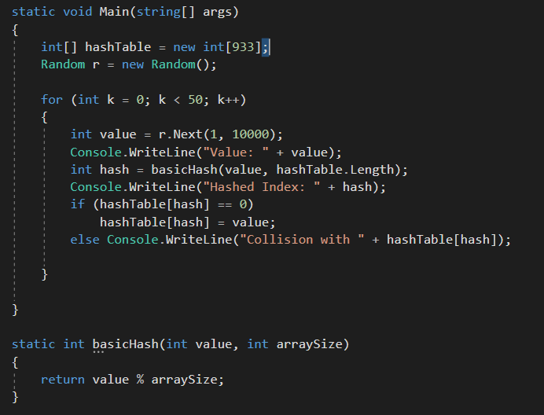
Most basic hash

Slide 7
Creating a better hash function
In most hash tables, your keys (the stuff to hash) will be strings
Even if it’s not, ToString() can make it a string for hashing purposes
Unifies types
We can then working with that string to create a similar hashing function based on what we already know (int % arraySize)
How would we do this?

Slide 8
Better hash function using strings
Take in a string and a size
1
Convert the string to a char array
2
Run through the charArray, getting the ASCII value of each character and adding them together
3
That gives you an int
4
Int % arraySize
5

Slide 9
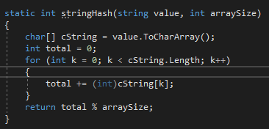
stringhash

Slide 10
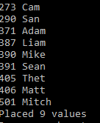
Choosing a size for your hashtable
Can be any prime number
10007 is a good prime number
Large enough for the majority of records in your table
Small enough that a single structure that large won’t degrade memory
What remains the problem with output here?

Slide 11
Creating a better stringhash
The spread of the values is still close together
We’re trying to avoid collisions as best as possible
We can complicate our hash function by having it compute the polynomial of 37 (a prime number) to allow for better distribution
Total += (37 * total) + int(cString[k])
Total % arraySize

Slide 12
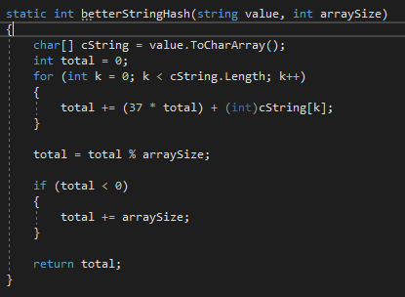
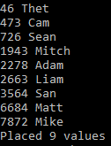
Better stringhash

Slide 13
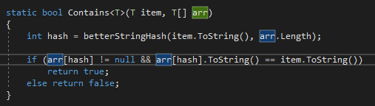
contains
Compute the hash
Check the array at the hash value
If it contains a value, it’s there

Slide 14
Creating a hashtable class
Based on what we know, we can start to create a generic hashtable class
Insert
Delete
Contains
Hash
ShowValues

Slide 15
collisions
Bucket Hashing
1
Open Addressing
2
Double Hashing
3

Slide 16
Bucket hashing
Currently, our HashTable will only insert if the position is not filled
We ignore collisions
Bucket hashing allows collisions by putting values in a bucket by their hashes
If two items hash to 57, put them both in an additional structure
You can, for example, have additional one dimensional arrays that double in size as they get to filling point

Slide 17
Open addressing
Bucket hashing has serious performance hits for when we need to search through additional inner-table structures
Open addressing just finds the nearest empty cell if the destination is full

Slide 18
Open addressing
Linear addressing moves up the array until an empty cell is found
01
This means that searching becomes less efficient: If an item ios not in the correct position, search the table until it is found (or not)
02
Quadratic probing formulaically chooses a new cell: 2 * collision number – 1
03
Quadratic probing makes subsequent searches for stray items quicker
04

Slide 19
Double hashing
If a collision is found, hash the hash value
Continue recurring this until an empty cell is found
The hash function can never return 0 (because then one might divide by 0)
The table size should be prime
Quadratic probing has better performance

Slide 20
Sparse tables
Let’s extend our HashTable class to deal with bucket hashing
It’s going to be a hashtable of LinkedLists!
This is referred to as a Sparse Table
Functionality is similar to a hashtable but has different setup and slightly different methods as we have to deal with inner LinkedLists

Slide 21
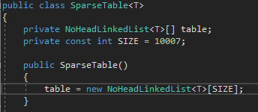
Setting up the sparsetable

Slide 22
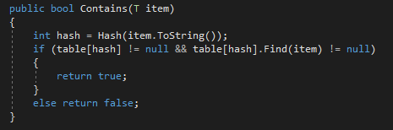
contains

Slide 23
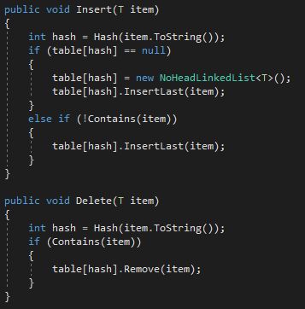
Insert and delete

Slide 24
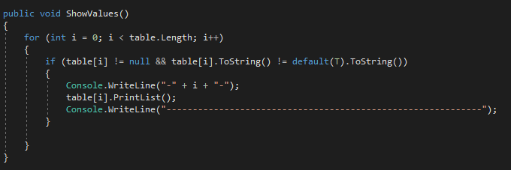
showvalues

Slide 25
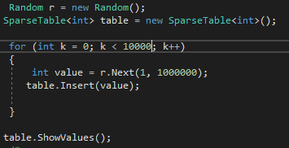
Important notes
Hash function stays the same as HashTable
To really see this at work with such a large sparse table, random 1000 numbers from 1 to 1000000 inside of our hash table and show the results

